Slide 1

The Project Life Cycle Module
Space Systems Engineering, version 1.0
Notes:
Version 1.0
SOURCE INFORMATION:
The material contained in this lecture was developed by Lisa Guerra of NASA’s Exploration Systems Mission Directorate while on assignment in the Department of Aerospace Engineering at the University of Texas at Austin. As part of a course entitled, Space Systems Engineering, the lecture was piloted at UT-Austin in Spring 2008.
The content that follows was also reviewed and edited by Dr. Paul Graf, Adjunct Professor at the University of Colorado at Boulder.

Slide 2
Module Purpose: The Project Life Cycle
  Describe the common project lifecycle phases, their purpose, activities, products and the review gates that separate them.
  Define what a system baseline is.
  Link project life cycle phases to the Vee systems engineering process model.
  Describe typical development times for each of the NASA project phases.

Slide 3
Introduction to the Project Life Cycle
  Lifecycle phases are used to help plan and manage all major aerospace system developments.
  Everything that should be done to accomplish a project is divided into distinct phases, separated by control gates.
    For NASA the phases are lettered: Pre-Phase A, Phase A, Phase B, Phase C, Phase D, Phase E, Phase F
  Phase boundaries are defined at natural points for project progress assessment and go/no go decisions.
    That is, should a project continue to the next phase, “go back to the drawing board” and redo some current phase work, or be terminated?
  Decomposing the project into life cycle phases organizes the development process into smaller more manageable pieces.
  Since early decisions commit later activities and more mature systems are harder to change, systems engineering done in the early phases has the greatest impact on mission success.
Notes:
Additional point to be made:
Sometimes, it is appropriate to perform some long lead-time activities ahead of the time they would normally be done. Long-lead-time activities might consist of technology developments, prototype construction and testing, or even fabrication of difficult components. Doing things out of their usual sequence increases risk in that those activities could wind up having been either unnecessary or improperly specified. On the other hand, overall risk can sometimes be reduced by removal of such activities from the critical path.
Ex: JWST mirror segments in beryllium. Flight units fabricated in Phase B.
Source: NASA SE Handbook SP-6150 (1995)

Slide 4
Major Project Reviews Precede
Each Key Decision Point
FORMULATION
IMPLEMENTATION
Pre-A
A
B
C
D
E
F
Project
Phases
Concept
Studies
Concept &
Technology
Development
Preliminary
Design &
Technology Completion
Final
Design &
Fabrication
System Assembly,
Test, & Launch
Operations &
Sustainment
Closeout
Key Decision Points
A
B
C
D
E
F
Mission Concept Review
Systems Requirements Review
Major Reviews
Mission/System Definition Review
Preliminary Design Review
Critical Design Review
Independent Cost
Estimates
Systems Integration Review
Operational Readiness Review
Flight Readiness Review
Post Launch Assessment Review
Decommissioning
Review
Notes:
Key Definitions
Formulation: The first part of the NASA management life cycle where system requirements are baselined, feasible concepts are determined, a system definition is baselined for the selected concept(s), and preparation is made for progressing to the Implementation Phase.
Implementation: The part of the NASA management life cycle the detailed design of system products is completed and the products to be deployed are fabricated, assembled, integrated and tested; and the products are deployed to their customers or users for their assigned use or mission.

Slide 5
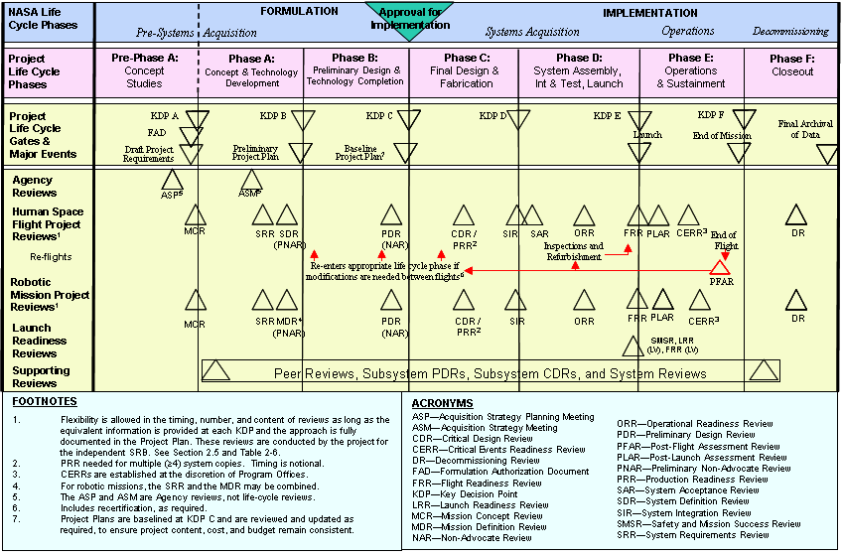
Large Projects May Add Subsystem Reviews Before Their Corresponding System Reviews
Notes:
Source: NASA NPR 7120.5D

Slide 6
Each Milestone Review
Creates A New System Baseline
A ‘baseline’ is both a noun and a verb.
  As a noun it is an agreed-to set of requirements, designs, or documents.
  As a verb it is the process of establishing an a baseline.
In the context of a system review, a baseline is also defined as a complete system description, including requirements, designs, or documents that will have changes controlled through a formal approval and monitoring, or configuration management process.
Since baselines capture the complete system description they are powerful tools in ensuring the entire team is working with the same requirements, designs, constraints, assumptions, interfaces, resource allocations and team responsibilities.

Slide 7
Project Life Cycle
Formulation Phases
The project life-cycle phases of formulation and implementation are divided into incremental pieces. This allows the development team to access their progress, estimate system and project performance, plan the next phase and allows decision makers to assess management and technical progress.
Formulation
  Pre-Phase A (Concept Studies)
  Purpose: To produce a broad spectrum of ideas and alternatives for missions from which new projects can be selected.
    Define the mission needs, goals & objectives.
    Perform studies of a broad range of mission concepts that contribute to goals and objectives.
    Develop draft project-level requirements, operations concept, and potential technology needs.
    Show that at least one mission concept can work.
    => Complete Mission Concept Review (MCR): review overall approaches as a baseline for Phase A.
Control Gate

Slide 8
Project Life Cycle
Formulation Phases, cont.
Formulation
  Phase A (Concept & Technology Development)
  Purpose: To determine the feasibility of a suggested new system in preparation for seeking funding.
    Define mission success, and minimum mission.
    Perform trade studies to compare mission concept options.
    Develop a baseline mission concept, including best technical approach, project execution, cost and schedule.
    Complete the requirements to the subsystem level.
    Identify requirements flow between and across subsystems.
    Begin needed technology developments.
    => Complete System Requirements Review (SRR): Review requirements as baseline for final concept. Establishes the System Requirements baseline.
    => Complete System Definition Review (SDR/MDR): Review baseline for Phase B. Establishes the Functional baseline.
Control Gates

Slide 9
Project Life Cycle
Formulation Phases, cont.
Formulation
  Phase B (Preliminary Design & Technology Completion)
  Purpose: To define the project in enough detail to establish an initial baseline capable of meeting mission needs.
    Refine concept of operations.
    Allocate functions and resources (e.g., mass margins).
    Requirements: continue to refine; define flow to the box level; develop verification matrix.
    Establish design solution that meets mission needs.
    Demonstrate that technology development is complete.
    => Preliminary Design Review (PDR): Review requirements, design and operations as baseline for detailed design. Establishes the Allocated baseline, also known as the ‘design-to’ baseline.
    => Non-Advocate Review (NAR)/Confirmation Review:
      Do the mission, spacecraft and instrument designs meet the mission/science requirements?
      Are management processes sufficient to develop and operate the mission?
      Do cost estimates, control processes and schedule indicate that the mission will be ready to launch on time and within budget?
Control Gates

Slide 10
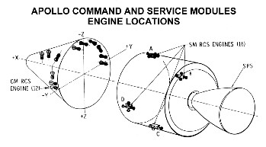
Project Life Cycle
Implementation Phases
Implementation (NASA officially commits to the approved integrated baseline)
  Phase C (Final Design and Fabrication)
  Purpose: To design a system (and its associated subsystems, including its operations systems) so that it will be able to meet its requirements.
    Demonstrate that the detailed system design meets requirements.
    Demonstrate that the design drawings are complete.
    Establishes the product baseline, also known as the ‘build-to’ baseline.
    Begin fabrication of test and flight article components, assemblies, and subsystems.
    => Critical Design Review (CDR): Review design drawings and test plans.
Control Gate

Slide 11
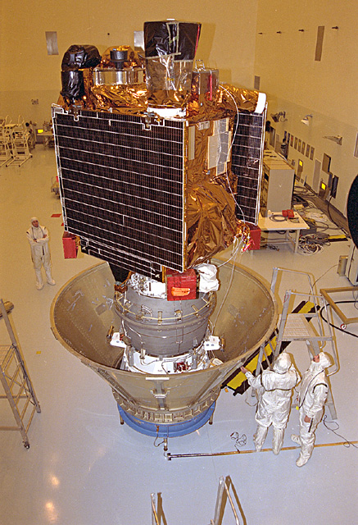
Project Life Cycle
Implementation Phases, cont.
Phase D (System Assembly, Integration and Test, and Launch)
  Purpose: To build the subsystems (including operations systems) and integrate them to create the system, while developing confidence that it will be able to meet the systems requirements.
    Perform system assembly, integration, and test.
    Verify system meets requirements.
    Prepare system for deployment.
    Launch system.
    Verify deployment and operations.
    => Complete Flight Readiness Review (FRR):
    review system preparedness for launch.
    Establishes the ‘As-built’ baseline
Control Gate
Mars Global Surveyor during integration and test.

Slide 12
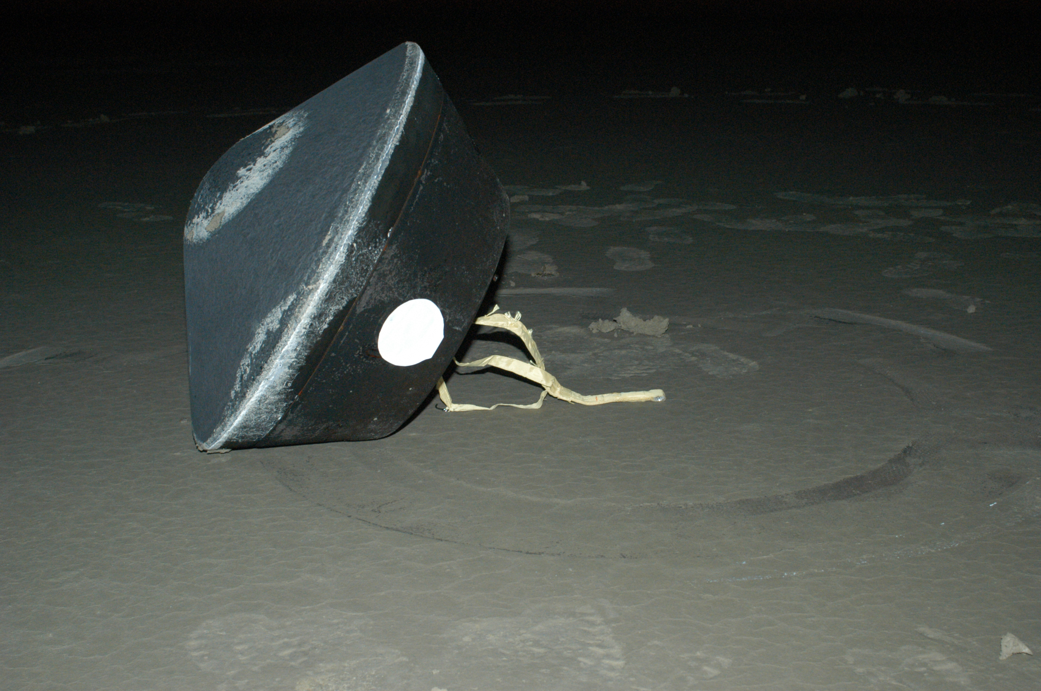
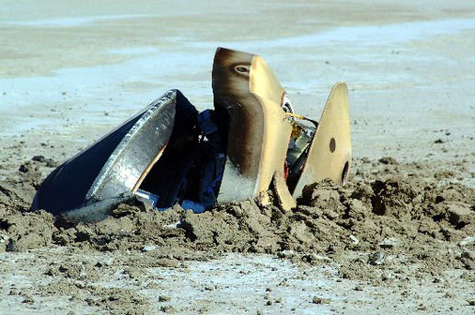
Project Life Cycle
Implementation Phases, cont.
  Phase E (Operations and Sustainment)
  Purpose: To ensure that the certified system is ready for operations.
    Implement the Mission Operations Plan developed in earlier phases.
    Collect and archive mission and science data.
    => Complete Post Launch Assessment Review (PLAR): Review to assess readiness to proceed with full, routine operations. Establishes the Operational (or ‘as-deployed’) baseline.
  Phase F (Closeout)
  Purpose: To dispose of the system in a responsible manner.
    Conduct a disposal review.
    Implement the Systems Decommissioning/ Disposal Plan.
    Perform analyses of the returned data and any returned samples.
Control Gate
Stardust Landing
Genesis Landing
Notes:
Pictures from NASA briefing: Genesis Mishap Investigation and Stardust Entry by Mike Ryschkewitsch from Goddard Space Flight Center
Pictures provide views of Phase F closeout and return of samples - one successful; one not.

Slide 13
Project Lifecycles - Incremental Development Phases Captured Via Baselines and Bounded by Technical Reviews
Phase A
Phase C
Phase E
Phase B
Phase D
Flight
Readiness
Review
System
Definition
Review
Post Launch
Assessment
Review
Functional
Baseline
Product
Baseline
As-Built
Baseline
Operational
Baseline
Need Specify Decompose Design Integrate Verify Operate Dispose
Notes:
Traditional System Development Life Cycle Model
Source INCOSE Systems Engineering Body of Knowledge; see:
http://g2sebok.incose.org/
Updated to match review and phase boundaries as defined in NASA NPR 7120.5D.
The traditional system development life cycle model provides a serial representation of major activities as well as well-defined reviews and document baselines. Time progresses from left to right in this model; most people are willing to agree that the activities in the boxes should not be serial. Generally though these process start and stop in the order presented.
Eight words that describe the sequential, primary focus of the system lifecycle:
Need, specify, decompose, design, integrate, verify, operate and dispose

Slide 14
Technical Baseline Definitions
System Requirements Baseline (Phase A)
  The system requirements baseline is the approved system level functional and performance requirements.
  Established at the System Requirements Review (SRR).
Functional Baseline (Phase A)
  The functional baseline is the approved documentation describing a system’s functional, performance, and interface requirements and the verifications required to demonstrate achievement of those specified characteristics.
  Established at the System Definition Review (SDR).
Allocated Baseline aka the ‘Design-to’ Baseline (Phase B)
  The allocated baseline extends the top-level performance requirements of the functional baseline to sufficient detail for initiating manufacturing or coding.
  Established at the Preliminary Design Review (PDR).
Product Baseline aka the ‘Build-to’ Baseline (Phase C)
  The product baseline describes detailed form, fit, and function characteristics; the selected functional characteristics designated for production acceptance testing; the production acceptance test requirements.
  Established at the Critical Design Review (CDR).
‘As-Built’ Baseline (Phase D)
  The as-built baseline describes the detailed form, fit, and function of the system as it was built.
  Established at the Flight Readiness Review (FRR).
Operational Baseline aka ‘As-Deployed’ Baseline (Phase E)
  The as-deployed baseline occurs at the Operational Readiness Review (ORR) . At this point, the design is considered to be functional and ready for flight. All changes will have been incorporated into the final documentation.
Notes:
Note that these definitions are also addressed in the Requirements — Configuration and Change Management module. Baselines are part of tracking the requirements configuration of the system.
You can choose to remove this slide from here, if you want to address baselines only in the requirements discussion.

Slide 15
The Engineering Activities in the Project Life Cycle
Mission
Requirements
& Priorities
System
Demonstration
& Validation
E
System Level
Develop System
Requirements &
System Architecture
Integrate System &
Verify
Performance Specs
A
Subsystems
Allocate Performance
Specs & Build
Verification Plan
Component
Integration &
Verification
Components
Design
Components
Verify
Component
Performance
Integration &
Verification Sequence
Decomposition &
Definition Sequence
B
Fabricate, Assemble,
Code &
Procure Parts
C
D
Time and Project Maturity

Slide 16
NASA Time Scales for Project Life Cycle
For a NASA Announcement of Opportunity (AO)-driven mission:
  The proposing team works Pre-Phase A in 1st round and
  Phase A in 2nd round (if they win). Lots of internal research & development (IRAD) dollars here.
  Official acceptance puts the mission/proposer into Phase B. Still has to go thru confirmation review to enter Phase C.
AO Mission Types
  Discovery Program example:
    Phase A Concept Study - 7 months
    Selection through launch ~ 7 years
  Mars Scout Program example:
    Phase A Concept Study - 9 months
    Selection through launch ~ 6 years
  Small Explorer Program example:
    Phase A Concept Study - 3 months
    Selection through launch ~ 3-4 years
For a facility-class telescope development, 10-15 years depending on technology development required.
For a human spacecraft development (Pre-phase A through Phase D/Launch), on the order of 10-20+ years.

Slide 17
Pause and Learn Opportunity
Produce in poster format the Defense Acquisition University (DAU) Wall chart - front & back (DAU_wallchart.pdf & DAU_WallchartBack.pdf).
Display the DAU life cycle wall charts in the classroom.
Compare the products, reviews and other aspects of the life cycle with the NASA version in the lecture module.
You can also refer to the Johnson Space Center version wall chart (PPF_WallChart_color.pdf) for comparison.

Slide 18
Alternatives to the Linear Project Life Cycle
The development life cycle is dependent upon the technical nature of what’s being developed => the project life cycle may need to be tailored accordingly.
  Alternatives exist in industry and the government.
Spiral development, often used in the software industry
  Where the development and construction activities proceed in parallel; follows the doctrine of successive refinement.
Rapid prototyping
  Produces partially operational mock-ups/prototypes early in the design (initiated during preliminary design phase) to allow for learning prior to production of expensive flight unit.
Skunkworks (Lockheed trademark)
  “A skunkworks is a group of people who, in order to achieve unusual results, work on a project in a way that is outside the usual rules. A skunkworks is often a small team that assumes or is given responsibility for developing something in a short time with minimal management constraints. Typically, a skunkworks has a small number of members in order to reduce communications overhead. A skunkworks is sometimes used to spearhead a product design that thereafter will be developed according to the usual process.”
Notes:
Possible class assignment:
The pros and cons of different approaches to system development. Pick a particular approach; provide an example flight system using that approach.

Slide 19
Module Summary: The Project Life Cycle
  A project is divided into distinct life cycle phases.
    Pre-Phase A: Concept studies
    Phase A: Concept and technology development
    Phase B: Preliminary design and technology completion
    Phase C: Final design and fabrication
    Phase D: System assembly, test and launch
    Phase E: Operations and sustainment
    Phase F: Closeout or disposal
  These phases are separated by control gates - typically associated with a major project review, such as preliminary design review (PDR).
  Each project phase has a distinct purpose and set of products.
  At the end of each phase a new system baseline — or an agreed-to set of requirements, designs, or documents — is established.
  A system baseline is the point of departure for the development work in each new phase.

Slide 20
Major Project Reviews Precede
Each Key Decision Point
FORMULATION
IMPLEMENTATION
Pre-A
A
B
C
D
E
F
Project
Phases
Concept
Studies
Concept &
Technology
Development
Preliminary
Design &
Technology Completion
Final
Design &
Fabrication
System Assembly,
Test, & Launch
Operations &
Sustainment
Closeout
Key Decision Points
A
B
C
D
E
F
Mission Concept Review
Systems Requirements Review
Major Reviews
Mission/System Definition Review
Preliminary Design Review
Critical Design Review
Independent Cost
Estimates
Systems Integration Review
Operational Readiness Review
Flight Readiness Review
Post Launch Assessment Review
Decommissioning
Review
Notes:
Key Definitions
Formulation: The first part of the NASA management life cycle where system requirements are baselined, feasible concepts are determined, a system definition is baselined for the selected concept(s), and preparation is made for progressing to the Implementation Phase.
Implementation: The part of the NASA management life cycle the detailed design of system products is completed and the products to be deployed are fabricated, assembled, integrated and tested; and the products are deployed to their customers or users for their assigned use or mission.

Slide 21
Backup Slides for Project Life Cycle Module

Slide 22
The Role of SE in the Project Life Cycle
Design is a top-down process while the Verification activity is a bottoms-up process. Components will be fabricated and tested prior to the subsystems. Subsystems will be fabricated and tested prior to the completed system.
Phase A-B
Phase D-E
System Level
Design Requirements
SDR
FRR
System Level
Definition & Design
Fabricate, Integrate & Test
Subsystems
Element
Item Level
Design Requirements
SIR
Component
PDR
CDR
Phase C
All Design Requirements Complete
Notes:
Note:
Diagram is referred to as the System Engineering “Vee”
Further explained in the 1995 NASA SE Handbook SP-6150, section 3.7
Also discussed in the DAU SE Fundamentals (figure 7.1)
Additional thoughts:
During earlier design stages, verification focuses on proof of concept for system, subsystem and component levels. During later stages, as the product
definition effort proceeds, the focus turns to verifying that the system meets the customer requirements.
Vee is a folder version of the ‘waterfall’ diagram. It is folded because the focus of the development at any one level is at the same level of system decomposition. I.e., component design on the left leg component verification on the right. It also emphasizes that as the system is being decomposed and designed on the left leg the team is thinking about how it will be verified and integrated on the right.

Slide 23
NASA Project Development Times Vary Widely
ATP-PDR = Phase A/B; PDR-CDR = Phase C; CDR-Launch = Phase D
Notes:
Source?

Slide 24
Historical Project Schedule Analysis (months)
 | Example | Phase A | Phase B | Phase C | Fab | ATLO | Total
All Inherited Technology | MGS | 3 | 3 | 6 | 5 | 9 | 26
New Engineering | Stardust, Genesis | 5 | 7 | 10 | 6 | 12 | 40
New Technology | CloudSAT GRACE | 6 | 8 | 10 | 9 | 12 | 45
Moderately Complex Payload with New Engineering | Magellan Odyssey Phoenix | 7 | 7 | 12 | 9 | 15 | 48
Moderately Complex Payload with New Technology | Pathfinder, Deep Impact, MER | 8 | 8 | 12 | 12 | 15 | 55
Highly Complex Payload with New Engineering | Mars Observer Voyager | 7 | 7 | 18 | 24 | 22 | 78
Highly Complex Payload with New Technology | Galileo, Cassini, MSL | 8 | 8 | 18 | 27 | 22 | 81
Notes:
Source: Jet Propulsion Lab (JPL) management course materials

Slide 25
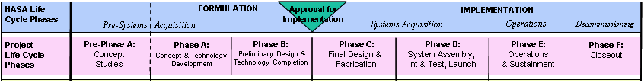
NASA Project Life Cycle
Key Definitions
  Formulation: The first part of the NASA management life cycle where system requirements are baselined, feasible concepts are determined, a system definition is baselined for the selected concept(s), and preparation is made for progressing to the Implementation Phase.
  Implementation: The part of the NASA management life cycle the detailed design of system products is completed and the products to be deployed are fabricated, assembled, integrated and tested; and the products are deployed to their customers or users for their assigned use or mission.

Slide 26

The Progression of Requirements
Life Cycle Relationships
Phase A
Phase B
Phase C
Phase D
Phase E
Concept
Studies
Concept & Technology
Development
Preliminary Design & Tech Completion
Final Design & Fabrication
System Assembly , Int & Test, Launch
Operations & Sustainment
Organizations
&
People
Artifacts
Problems
CONOPS
Prelim.
Design
Design-to
Specs
As-built
As-
deployed
Concepts
System
Reqmts.
Subsystem
Reqmts.
Build-to
Specs
As-verified
As-
operated
Expecta-
tions
Validation
Plan
Verificat’n
Plan
Verificat’n
Procedures
Anomalies
Notes:
9903

